Slide 1

Comp 401 Synchronized Methods
Instructor: Prasun Dewan

Slide 2
Prerequisite
Animation Threads Commands
More?

Slide 3

Threads and Sharing
Same Lane ~ Same Object/Resource
Different Lane ~ Different Objects/Resources
Sharing Road ~ Sharing Computer

Slide 4
The Separate Lane Scenario
AnObservablePlotted
Shuttle
AnObservablePlotted
Shuttle
setShuttleX(Y)()
setShuttleX(Y)()
Shared lane?
AShuttleAnimator
animate Shuttle()
AShuttleAnimator
animate Shuttle()
AShuttleAnimation Command
AShuttleAnimation Command
run()
run()
Call Diagram
Thread
Thread
Node labels: Method and Class/Interface
start()
start()
Main Thread
Edges denote calls
Main Class
start()
main()

Slide 5
One Shuttle & Animator, Two Threads
AnObservablePlotted
Shuttle
setShuttleX(Y)()
Two threads accessing same animator and shuttle
AShuttleAnimator
animate Shuttle()
AShuttleAnimation Command
AShuttleAnimation Command
run()
run()
Shuttle Animation Thread 1
Shuttle Animation Thread 2
start()
start()
Main Thread
Main Class
start()
main()

Slide 6
Two Shuttles and Animators, Two Threads
public static void main(String[] args) {
PlottedShuttle shuttle1 = new AnObservablePlottedShuttle(50, 100);
OEFrame oeFrame1 = ObjectEditor.edit(shuttle1);
oeFrame1.hideMainPanel();
oeFrame1.setLocation(0, 0);
oeFrame1.setSize(400, 400);
PlottedShuttle shuttle2 = new AnObservablePlottedShuttle(100, 50);
OEFrame oeFrame2 = ObjectEditor.edit(shuttle2);
oeFrame2.hideMainPanel();
oeFrame2.setLocation(400, 0);
oeFrame2.setSize(400, 400);
ShuttleAnimator shuttleAnimator1 = new AShuttleAnimator();
ShuttleAnimator shuttleAnimator2 = new AShuttleAnimator();
concurrentDemoShuttleAnimation(shuttleAnimator1, shuttle1);
concurrentDemoShuttleAnimation(shuttleAnimator2, shuttle2);
}
Two different threads are created which interleave their activities

Slide 7
One Shuttles & Animator, Two Threads
public static void main(String[] args) {
PlottedShuttle shuttle1 = new AnObservablePlottedShuttle(50, 100);
OEFrame oeFrame1 = ObjectEditor.edit(shuttle1);
oeFrame1.setLocation(0, 0);
oeFrame1.setSize(500, 550);
ShuttleAnimator aShuttleAnimator = new AShuttleAnimator();
concurrentDemoShuttleAnimation(aShuttleAnimator, shuttle1);
ThreadSupport.sleep(500);
concurrentDemoShuttleAnimation(aShuttleAnimator, shuttle1);
}
Each thread manipulates the same shuttle
Second thread starts with a 500 ms delay

Slide 8
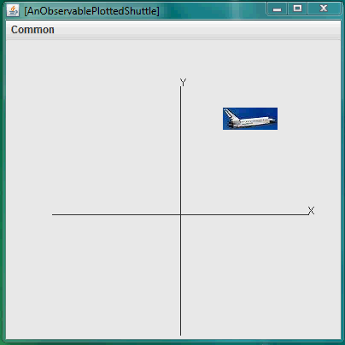
Interfering Animations

Slide 9
Interference
while (curY < originalY) {
ThreadSupport.sleep(animationPauseTime);
curY += animationStep;
shuttle.setShuttleY(curY);
}
while (curY < originalY) {
ThreadSupport.sleep(animationPauseTime);
curY += animationStep;
shuttle.setShuttleY(curY);
}
Each call of method gets its own copy of local variables such as curX and curY

Slide 10
Top thread Sets its CurY
while (curY < originalY) {
ThreadSupport.sleep(animationPauseTime);
curY += animationStep;
shuttle.setShuttleY(curY);
}
while (curY < originalY) {
ThreadSupport.sleep(animationPauseTime);
curY += animationStep;
shuttle.setShuttleY(curY);
}

Slide 11
Top Thread Sleeps
while (curY < originalY) {
ThreadSupport.sleep(animationPauseTime);
curY += animationStep;
shuttle.setShuttleY(curY);
}
while (curY < originalY) {
ThreadSupport.sleep(animationPauseTime);
curY += animationStep;
shuttle.setShuttleY(curY);
}

Slide 12
Bottom Thread Sets its Cury
while (curY < originalY) {
ThreadSupport.sleep(animationPauseTime);
curY += animationStep;
shuttle.setShuttleY(curY);
}
while (curY < originalY) {
ThreadSupport.sleep(animationPauseTime);
curY += animationStep;
shuttle.setShuttleY(curY);
}

Slide 13
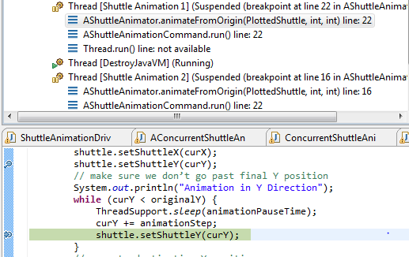
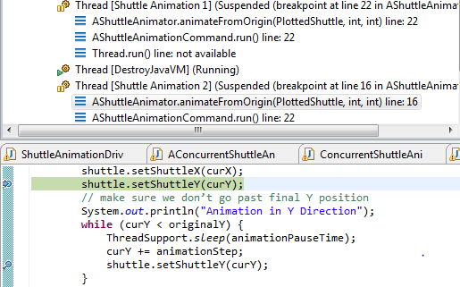
Interference

Slide 14
Solution?
AnObservablePlotted
Shuttle
setShuttleX(Y)()
What?
How?
AShuttleAnimator
animate Shuttle()
AShuttleAnimation Command
AShuttleAnimation Command
run()
run()
Shuttle Animation Thread 1
Shuttle Animation Thread 2
start()
start()
Main Thread
Main Class
start()
main()

Slide 15
Synchronized Version
public class ASynchronizedShuttleAnimator
extends AShuttleAnimator {
public synchronized void animateFromOrigin(
PlottedShuttle shuttle,
int animationStep,
int animationPauseTime) {
super.animateFromOrigin(
shuttle,
animationStep,
animationPauseTime);
}
}
Should use keyword synchronized in method with shared data to tell Java that only one thread should execute the method at one time
Atomic method execution – only one thread executes it at one time
When a method is locked by a thread other threads wait in a queue, and when a method is unlocked the first waiting thread executes it

Slide 16
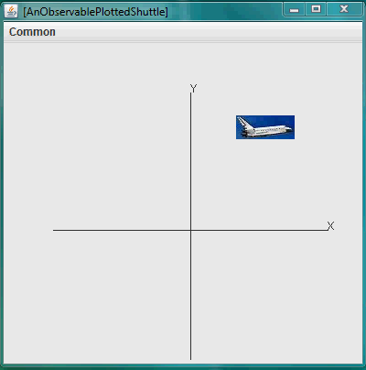
Synchronized

Slide 17

One Shuttle and Synchronized Animator, Two Threads
AnObservablePlotted
Shuttle
On what method should lock be put?
setShuttleX(Y)()
AShuttleAnimator
animate Shuttle()
AShuttleAnimation Command
AShuttleAnimation Command
run()
run()
Shuttle Animation Thread 1
Shuttle Animation Thread 2
Main Thread
Main Class
main

Slide 18
Synchronize Set methods of Shuttle?
AnObservablePlotted
Shuttle
Set method executes without interference, not animation loop
setShuttleX(Y)()
AShuttleAnimator
animate Shuttle()
AShuttleAnimation Command
AShuttleAnimation Command
run()
run()
Shuttle Animation Thread 1
Shuttle Animation Thread 2
Main Thread
Main Class
main

Slide 19
Synchronize Run Methods of Command?
AnObservablePlotted
Shuttle
Each command has its own queue
setShuttleX(Y)()
AShuttleAnimator
animate Shuttle()
AShuttleAnimation Command
AShuttleAnimation Command
run()
run()
Shuttle Animation Thread 1
Shuttle Animation Thread 2
Main Thread
Main Class
main

Slide 20
Synchronize Thread Creation?
AnObservablePlotted
Shuttle
Threads created atomically, but then they can interfere
setShuttleX(Y)()
AShuttleAnimator
animate Shuttle()
AShuttleAnimation Command
AShuttleAnimation Command
run()
run()
Shuttle Animation Thread 1
Shuttle Animation Thread 2
Main Thread
Main Class
main

Slide 21
Synchronize Thread Creator?
public synchronized static void concurrentDemoShuttleAnimation(
ShuttleAnimator aShuttleAnimator, PlottedShuttle aShuttle) {
Thread thread = new Thread(this, animateFromOriginMethod,
new Object[] {aShuttle, 5, 100});
threadNumber++;
thread.setName(SHUTTLE_THREAD_NAME + " " + threadNumber);
thread.start();
}
Synchronize makes caller wait till interfering activity finishes
Method executed by new thread should be synchronized, not the method that created the thread.

Slide 22
Two Synchronized Methods
public class ASynchronizedShuttleAnimator
extends AShuttleAnimator {
public synchronized void animateFromOrigin(
PlottedShuttle shuttle,
int animationStep,
int animationPauseTime) {
super.animateFromOrigin(
shuttle,
animationStep,
animationPauseTime);
}
public synchronized void animateFromOrigin(
PlottedShuttle shuttle,
int animationStep,
int animationPauseTime, OEFrame frame) {
super.animateFromOrigin(
shuttle,
animationStep,
animationPauseTime,
frame);
}
}
Only one synchronized method can be executed at one time in a class
Lock and queue is with the object, not method

Slide 23
Synchronized Methods
Start call to synchronized method on object O
if some synchronized method is executing in O, then makes calling thread wait in O’s queue
Finish call to synchronized method on object O
Unblocks first waiting thread in O’s queue

Slide 24
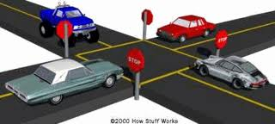
Synchronized Method Analogy?

Slide 25
One Shuttle, Two Synchronized Animators
public class OneShuttleTwoSynchronizedShuttleAnimators
extends ConcurrentShuttleAnimationDriver {
public static void main(String[] args) {
PlottedShuttle shuttle1 =
new AnObservablePlottedShuttle(50, 100);
OEFrame oeFrame = ObjectEditor.edit(shuttle1);
oeFrame.hideMainPanel();
oeFrame.setSize(400, 400);
ShuttleAnimator aShuttleAnimator1 =
new ASynchronizedShuttleAnimator();
ShuttleAnimator aShuttleAnimator2 =
new ASynchronizedShuttleAnimator();
concurrentDemoShuttleAnimation(aShuttleAnimator1, shuttle1);
ThreadSupport.sleep(500);
concurrentDemoShuttleAnimation(aShuttleAnimator2, shuttle1);
}
}
Lock, queue is with each object, not the class
Will again get interference

Slide 26
One Shuttle, Two Threads and Synchronized Animators
APlotted
Shuttle
setShuttleX(Y)()
ASynchronizedShuttleAnimator
animate Shuttle()
ASynchronizedShuttleAnimator
animate Shuttle()
AShuttleAnimation Command
AShuttleAnimation Command
run()
run()
Need to define our own synchronization protocol
Shuttle Animation Thread 1
Shuttle Animation Thread 2
Main Thread
Main Class
main

Slide 27
Synchronization
Methods that access global state and can be executed by multiple threads should be made synchronized
Only one synchronized method in an object will be executed at one time.

